Slide 1

Google Summer of Code
Operating Systems Special
Stefanos Baziotis
stefanos.baziotis@gmail.com

Slide 2
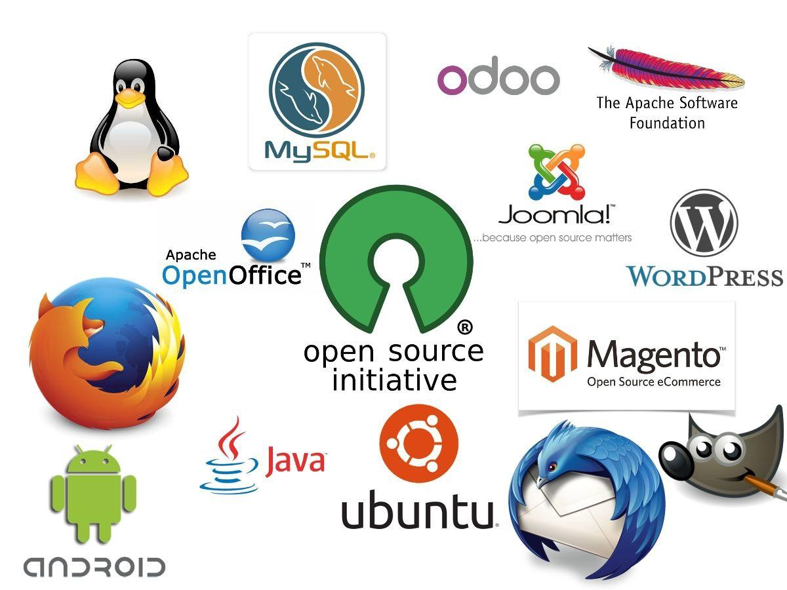
What is Google
Summer of Code ?

Slide 3

What is Google
Summer of Code ?
+

Slide 4

What is Google
Summer of Code ?
+
+

Slide 5

What is Google
Summer of Code ?
+
+

Slide 6
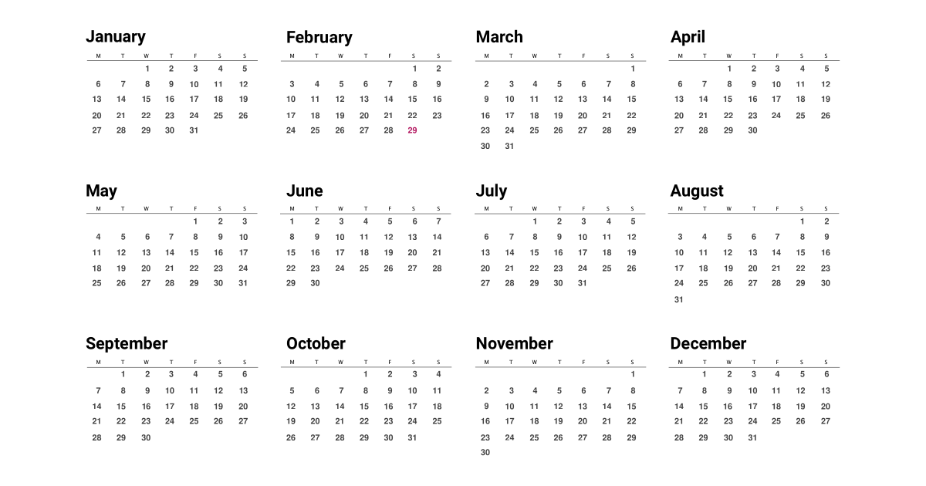
Timeline

Slide 7
Timeline
Organizations Announced

Slide 8
Timeline
Organizations Announced
Preparation / Proposals

Slide 9
Timeline
Organizations Announced
Preparation
Proposals

Slide 10
Timeline
Organizations Announced
Preparation
Proposals
Bonding

Slide 11
Timeline
Organizations Announced
Preparation
Proposals
Bonding
Coding Period

Slide 12
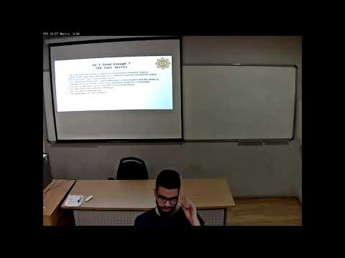
Last Year’s Talk

Slide 13
Changes 2021

Slide 14

Changes 2021

Slide 15

Changes 2021

Slide 16
Changes 2021
Daily

Slide 17
Changes 2021
Daily
Overall

Slide 18

Changes 2021
Daily
Overall
EXAMS!

Slide 19

Real-Time Executive for Multiprocessor Systems

Slide 20
RTEMS -
2020 Project -
Improving the Scheduler
Basic scheduling knowledge
C knowledge

Slide 21

The GNU Project

Slide 22
GNU Poke
Low-level binary data interpretation

Slide 23
GNU Poke
Low-level binary data interpretation
You do that all semester:
Passing data over pipes

Slide 24
GNU Poke
Low-level binary data interpretation
You do that all semester:
Passing data over pipes
exec()’ing programs

Slide 25
GNU Poke -
2020 Project
Pipes and sockets

Slide 26
GNU Poke -
2020 Project
Pipes and sockets
Reading C code

Slide 27
GNU Poke -
2020 Project
Pipes and sockets
Reading C code
Everything else learned

Slide 28
GNU XaoS
Fractal Viewer / Zoomer

Slide 29
GNU XaoS -
2020 Project
Fractal Viewer / Zoomer
Manipulating files

Slide 30
GNU XaoS -
2020 Project
Fractal Viewer / Zoomer
Manipulating files
Floating-Point work

Slide 31

Chapel

Slide 32
Chapel
Parallel Programming Language

Slide 33
Chapel -
2020 Project
Adding Sequential Data Structures

Slide 34
Chapel -
2020 Project
Adding Sequential Data Structures
YOU can do that!

Slide 35

strace

Slide 36
strace -
2020 project
processes stuff

Slide 37
strace -
2020 project
processes stuff
trie implementation

Slide 38
strace -
2020 project
processes stuff
trie implementation
testing

Slide 39
Thanks to Mr. Alex Delis!
Stefanos Baziotis
stefanos.baziotis@gmail.com

